Slide 1


Slide 2

The Blessings
(3, 4, 6, 11) Matthew 10:29-31 Colossians 1:10

Slide 3
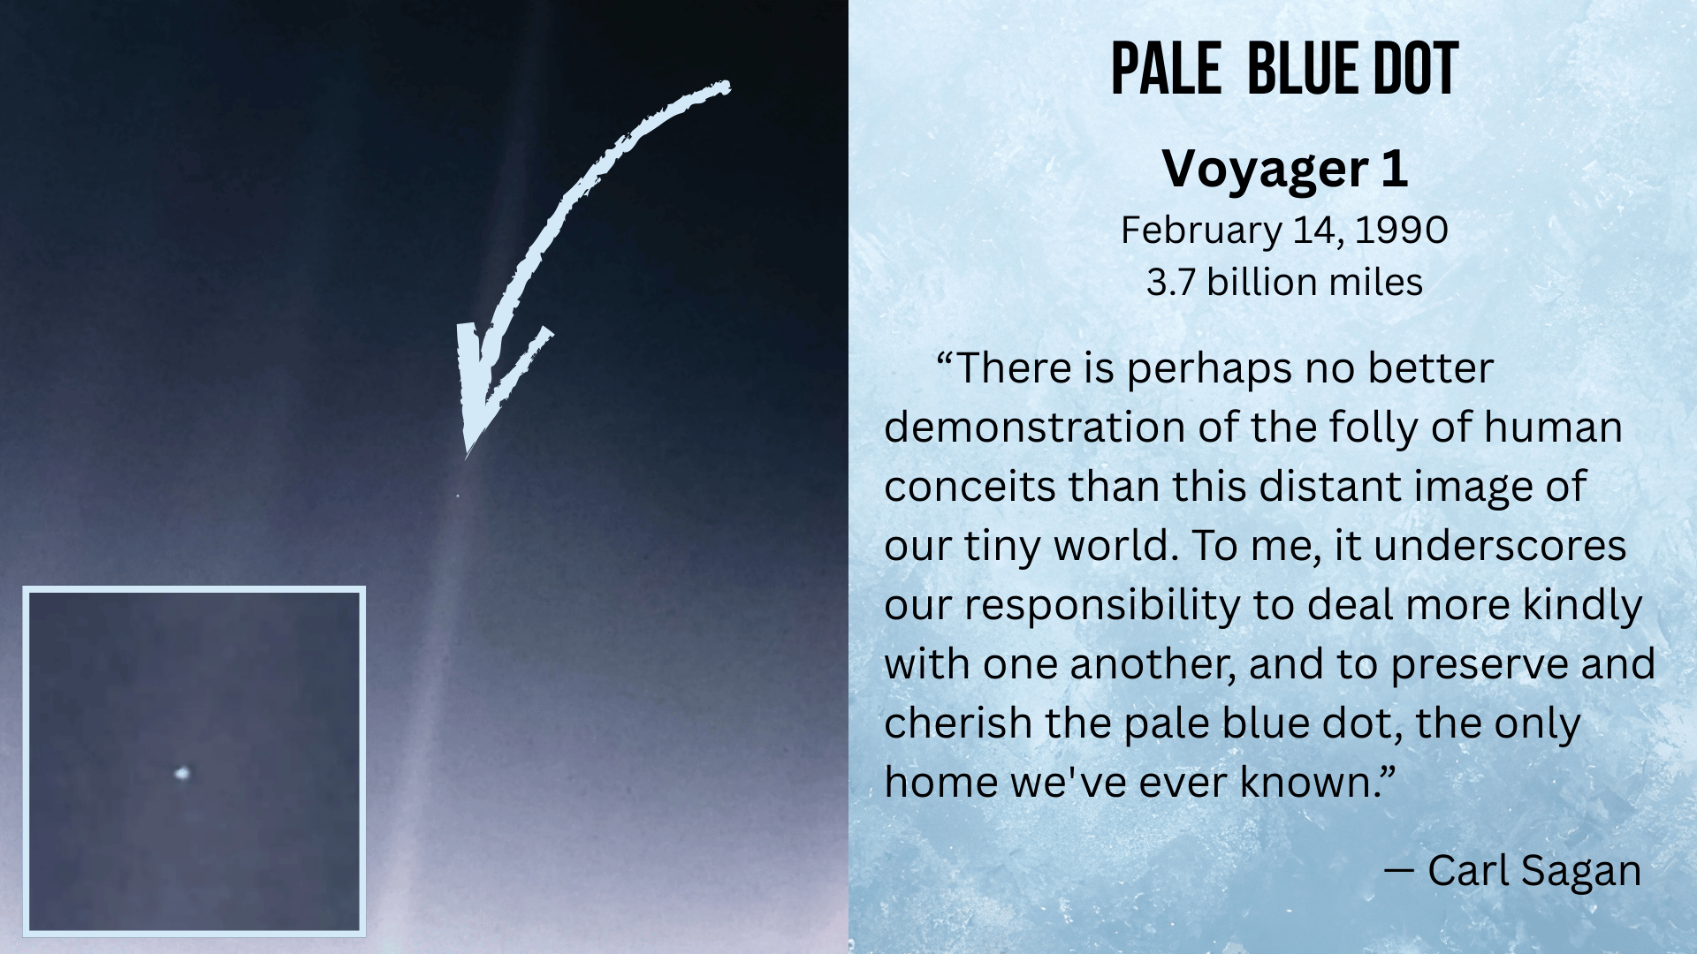

Slide 4
The Blessings
(3, 4, 6, 11) Matthew 10:29-31 Colossians 1:10
The Power & Authority
(8, 9, 13, 14, 13-14, 16-18) Matthew 6:31-33 Matthew 8:23-27
Great Gift: His Will
(19-20) Mark 16:15-16

Slide 5

Conclusion
Not only do we praise Him, we promise to do better!
(Mindful worship, Honor God’s Word, Praise Him)
Praise the Lord!

